Slide 1
Top Ten Companies

Slide 2
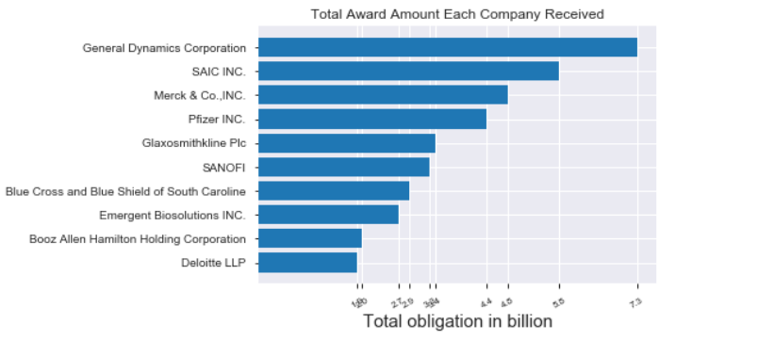
Total Dollar Amount Received By Top Ten Companies (2012-2019 total in billions of dollars)
RINA

Slide 3
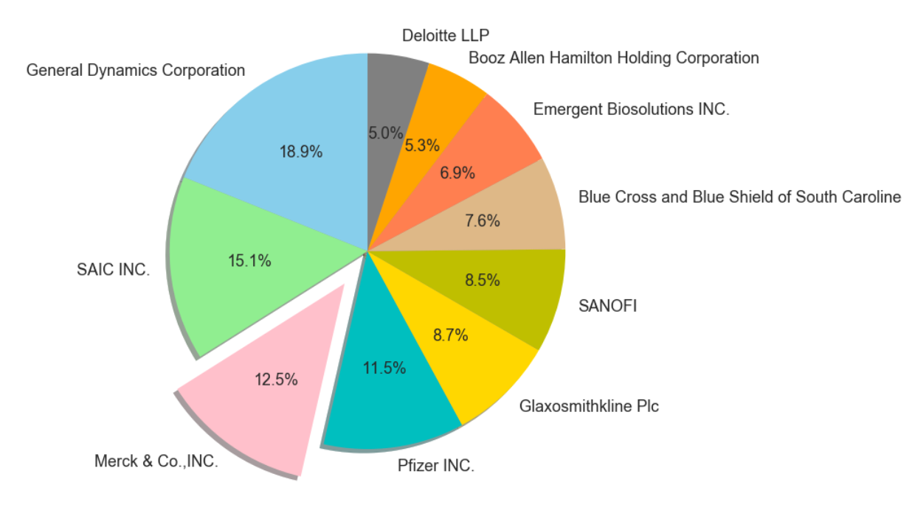
Comparison of Top Ten Companies within the Top Ten List
RINA

